Slide 1
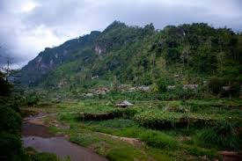
The Best Place that I Have Ever Lived
By Juce Mary

Slide 2
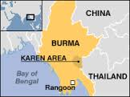
This is the place that I lived before with my family.
BBC NEWS | Asia-Pacific | Analysis: Burma's Karen talk

Slide 3
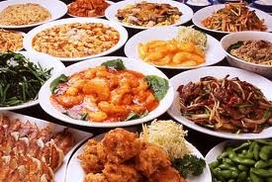
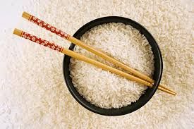
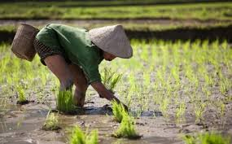
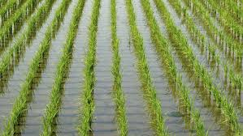
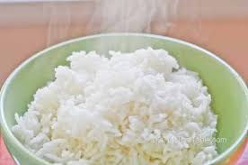
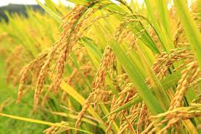
This is how we got food and water.
In Burma, we ate rice. We used to farm and we got water from the river.
Food and Water

Slide 4
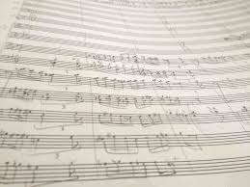
Here are some videos about Karen music in Burma:
http://www.youtube.com/watch?v=XdEuv19iWZY\
http://www.youtube.com/watch?v=pp27SmUnf-E

Slide 5
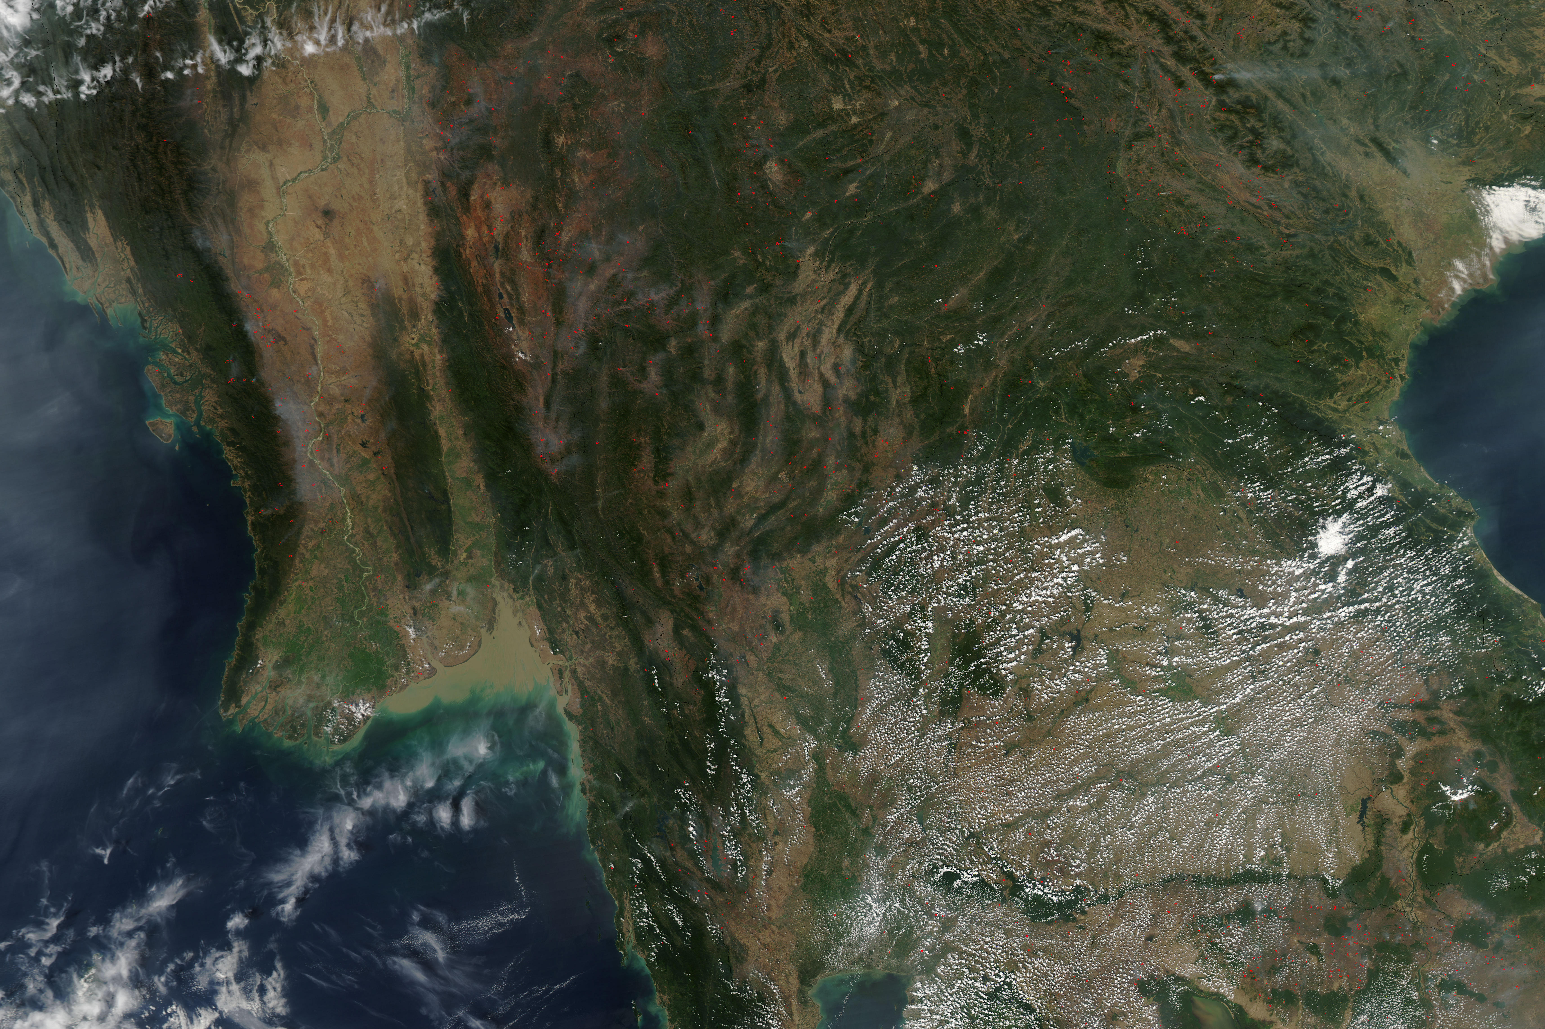
Geography:
In Burma, we have mountains and rivers. We also have tropical rainforests.

Slide 6
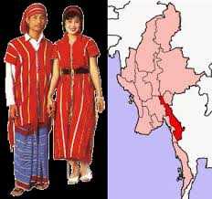
Clothing
These clothes are made by women.
We wear Karen clothes to represent who we are and where we are from. We have to wear Karen clothes for dancing and to celebrate the New Year.

Slide 7
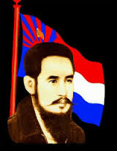
The Karen government in Burma
Government and the People in Burma
Saw Ba U Gyi was born in Bassin in 1905 to a wealthy landlord. After completing University in Rangoon, in 1925, he became a lawyer and was called to the English Bar two years later.
His family was rich, but he gave his money to the poor people. He worked for peace and he became President inBurma.

Slide 8
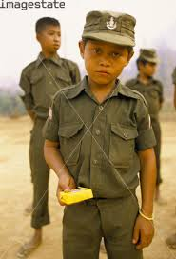
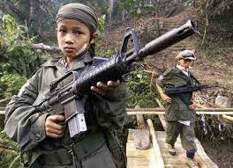
Soldiers
When you are 12 or 13 years old, you have to join the Karen Army.
For example, if you have three or four brothers, two of them have to join the Army.
You have to be strong and fast to join the Army.
We, the Karen people of Burma, have been cornered into fighting against ruling Burmese Governments for the past forty-three years. [in 1992]

Slide 9
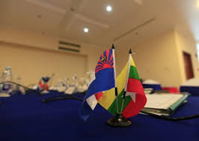

Flag
These flags represent the country and the people of Burma. The Karen flag has four colors.

Slide 10
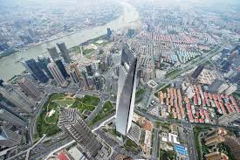
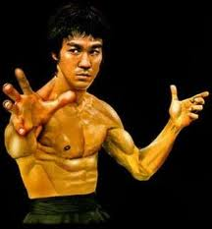
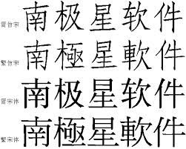
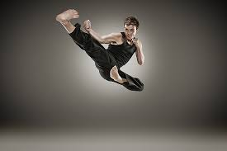
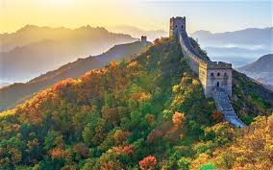
The place that I want to go in the future is China.
The reason why I want to go is to learn Kung Fu.
I also want to learn the language.
I want to see the Great Wall of China.

Slide 11
References
I got information from google website.
I got information from image .
I got some information from my brain.
I got some information from YouTube.

